Slide 1
CS 61A Topical Review
Streams
slides: links.cs61a.org/keon-slides
Notes:
Slides posted after review session

Slide 2
Lazy Scheme Lists
Similar to how Python has “lazy evaluation” with generators, Scheme supports it with streams, which are variations of Scheme lists (linked lists)
Definition: a Scheme list where the cdr is only “promised” to exist, not evaluated in the initial expression
Syntax: (cons-stream <car> <promised cdr>)
Access the promised value with cdr-stream

Slide 3
Stream Properties
Lazy Evaluation
Only compute values when asked to do so (cdr-stream)
Each element not explicitly stored in memory (Scheme doesn’t know the next item until it gets there)
Memoization
Remember any values that have been computed so far
#[promise (not forced)] vs #[promise (forced)]
No recomputations!

Slide 4
Stream Example
(cons 1 (/ 1 0))
(cons-stream 1 (cons-stream 2 (/ 1 0)))

Slide 5
Stream Example
(cons 1 (/ 1 0))
Error
(cons-stream 1 (cons-stream 2 (/ 1 0)))
(1 . #[promise (not forced)])
Notes:
Note how the cons-stream returns a pair! This is because using cdr only shows Scheme that a promise exists. A promise isn’t a list, so this linked list is “malformed”.

Slide 6
Why Streams?
The properties (lazy evaluation, memoization) are useful to save memory and space in the real world, which allows for…
Streams that never end!
Infinite streams can be used to constantly compute new values

Slide 7
Infinite Stream Example
(define (naturals n)
(cons-stream n (naturals (+ n 1))
)
)
What does this do?

Slide 8
Infinite Stream Example
(define (naturals n)
(cons-stream n (naturals (+ n 1))
)
)
Endlessly computes all natural numbers
starting from n
Notes:
Tip: for code writing problems, it’s very similar in approach to the recursive logic you’ve learned with making lists using cons.

Slide 9
Any questions?

Slide 10
WWSD Practice

Slide 11
WWSD
scm> (define x (cons-stream 1
(cons-stream y (+ y 1))
))
scm> (define y 2)
scm> (car x)
?
scm> (cdr x)
?
scm> (cdr-stream x)
?
scm> (cdr x)
?
scm> (define y 5)
scm> (cdr-stream (cdr-stream x))
?
Notes:
First, is this define allowed? If it is, why?
Ans: even though y has yet to be defined, Scheme does not evaluate it so as long as we have it defined when cdr-stream evaluates that variable, there will be no errors.

Slide 12
WWSD
scm> (define x (cons-stream 1
(cons-stream y (+ y 1))
))
scm> (define y 2)
scm> (car x)
1
scm> (cdr x)
#[promise (not forced)]
scm> (cdr-stream x)
(2 . #[promise (not forced)])
scm> (cdr x)
#[promise (forced)]
scm> (define y 5)
scm> (cdr-stream (cdr-stream x))
6
Notes:
How would we get 2 out of this stream?
Ans: cdr-stream and get the car of the result.

Slide 13
WWSD (cont.)
scm> (define x (cons-stream 1
(cons-stream y (+ y 1))
))
scm> (define y 2)
scm> (cdr-stream x)
?
scm> (cdr-stream (cdr-stream x))
?
scm> (define y 5)
scm> (cdr-stream (cdr-stream x))
?
Notes:
What has changed since the last slide?
What property does this showcase for streams?

Slide 14
WWSD (cont.)
scm> (define x (cons-stream 1
(cons-stream y (+ y 1))
))
scm> (define y 2)
scm> (cdr-stream x)
(2 . #[promise (not forced)])
scm> (cdr-stream (cdr-stream x))
3
scm> (define y 5)
scm> (cdr-stream (cdr-stream x))
3
Notes:
What has changed since the last slide?
What property does this showcase for streams?

Slide 15
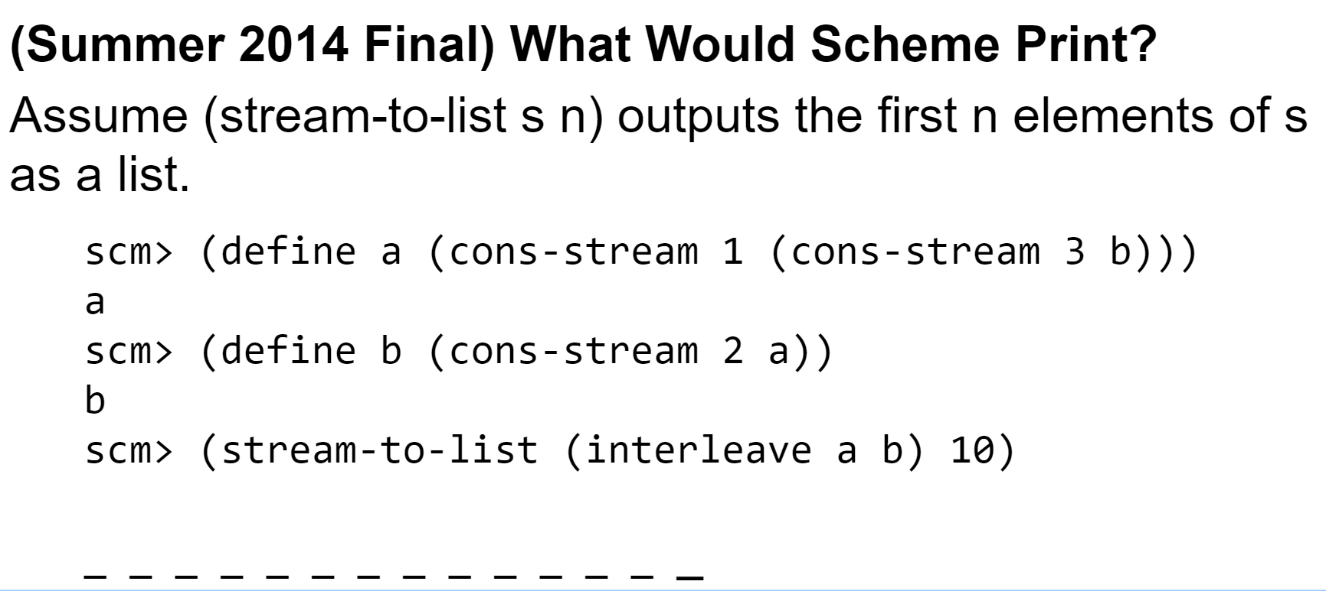
WWSD Final
Notes:
Interleave: a procedure that mixes two streams and alternates between them (first item of a, followed by first of b, then second of a, etc.)

Slide 16
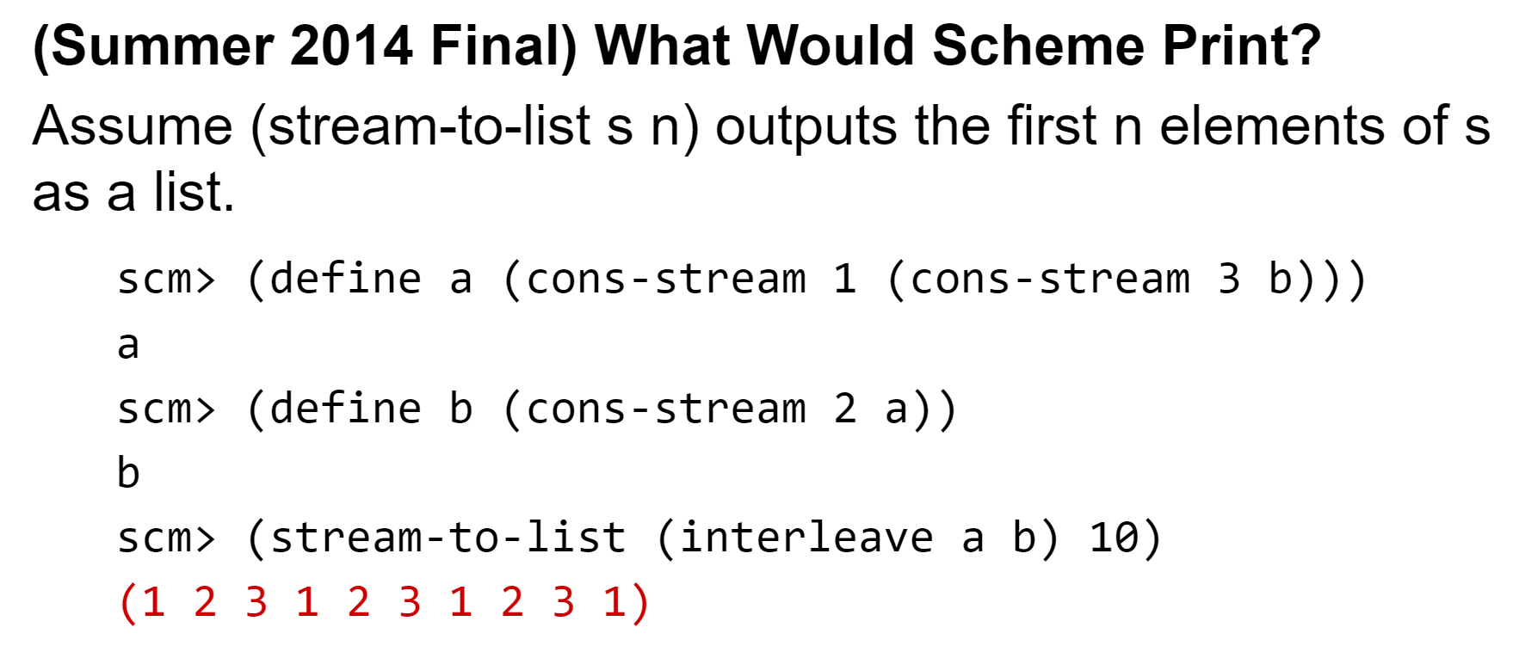
WWSD Final Sol.

Slide 17
Coding Practice

Slide 18
Implement double, which takes in a stream and outputs another stream where each value is doubled and repeated twice. (ex: (1 2 3) → (2 2 4 4 6 6))
(define (double s)
; YOUR CODE HERE
)

Slide 19
(define (double s)
(if (null? s) s
(cons-stream (* 2 (car s))
(cons-stream (* 2 (car s)) (double (cdr-stream s)))
)
)
)
Notes:
Why do we need the if case?
Ans: streams need two items, so we need to terminate at the end of the stream if it’s not infinite (otherwise calling cdr-stream on the last item in the stream would yield an error)

Slide 20
Implement fib, which outputs a Fibonacci stream where every number is the sum of the two preceding. (ex: 1, 1, 2, 3, 5, 8)
Hint: Use a helper!
Hint #2: Which two numbers aren’t sums of the preceding?
(define (fib)
; YOUR CODE HERE
)
Notes:
Does not use combine-with, which was used in discussion!

Slide 21
(define (fib)
(define (helper a b)
(cons-stream __________ _______________________)
)
(cons-stream ______ (cons-stream ____ ______________))
)

Slide 22
(define (fib)
(define (helper a b)
(cons-stream (+ a b) (helper b (+ a b)))
)
(cons-stream 1 (cons-stream 1 (helper 1 1)))
)

Slide 23
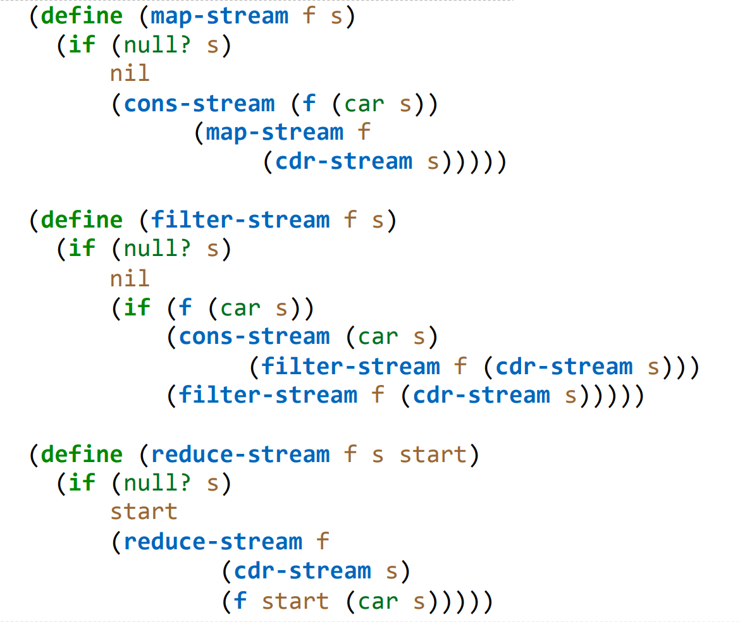

Slide 27
Define a function interleave, which takes in
two infinite streams <a1, a2, ...> and <b1, b2, …> and outputs the stream <a1, b1, a2, b2, ...>
(define (interleave a b)
; YOUR CODE HERE
)

Slide 28
(define (interleave a b)
(cons-stream
(car a)
(cons-stream
(car b)
(interleave (cdr-stream a)
(cdr-stream b))
)
)
)
Notes:
For fun, could ask how to tweak this if the input was not guaranteed to be infinite
Ans: Add a (if (null? a) b) (if (null? b) a), or put both null checks and the final cons-stream in a cond.

Slide 29
Define a function partial_sums, which takes in a stream <a1, a2, a3, ...> and outputs the stream <a1, a1 + a2, a1 + a2 + a3, ...>. The input stream can be finite or infinite.
(define (partial_sums s)
; YOUR CODE HERE
)

Slide 30
(define (partial-sums s)
(define (helper curr total)
(if (null? curr)
nil
(cons-stream
(+ total (car curr))
(helper (cdr-stream curr) (+ total (car curr)))
)
)
)
(helper s 0)
)

Slide 31
(define (partial-sums s)
(define (helper curr total)
(if (null? curr)
nil
(cons-stream
(+ total (car curr))
(helper (cdr-stream curr) (+ total (car curr)))
)
)
)
(helper s 0)
)

Slide 32
Section Summary
Streams are Scheme’s approach to generators
Builds on the idea of Scheme linked lists and lazy evaluation
Involves usage of cons and cdr, except with -stream behind them.
Recursive structure, so typically a recursive call
at the end of the cons-stream

Slide 33
Any questions?
Contact me at keonktsang@berkeley.edu if you think of something later.
Slides can be found at:
links.cs61a.org/keon-slides

